Slide 1
Тестовое задание
File created on: 2/27/2025 6:32:10 PM

Slide 2
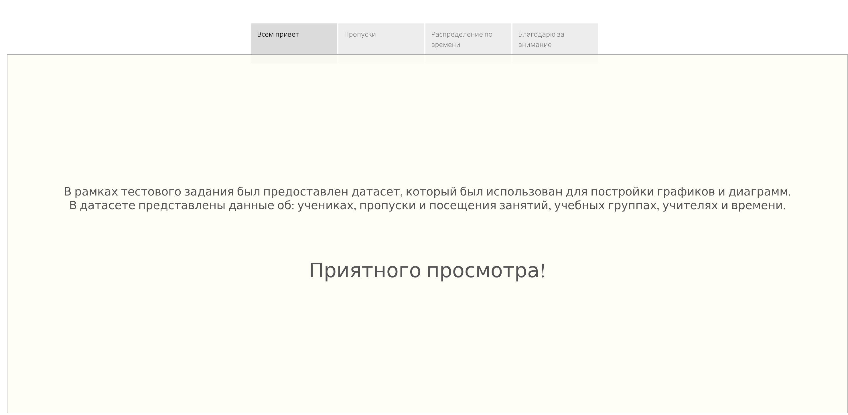

Slide 3
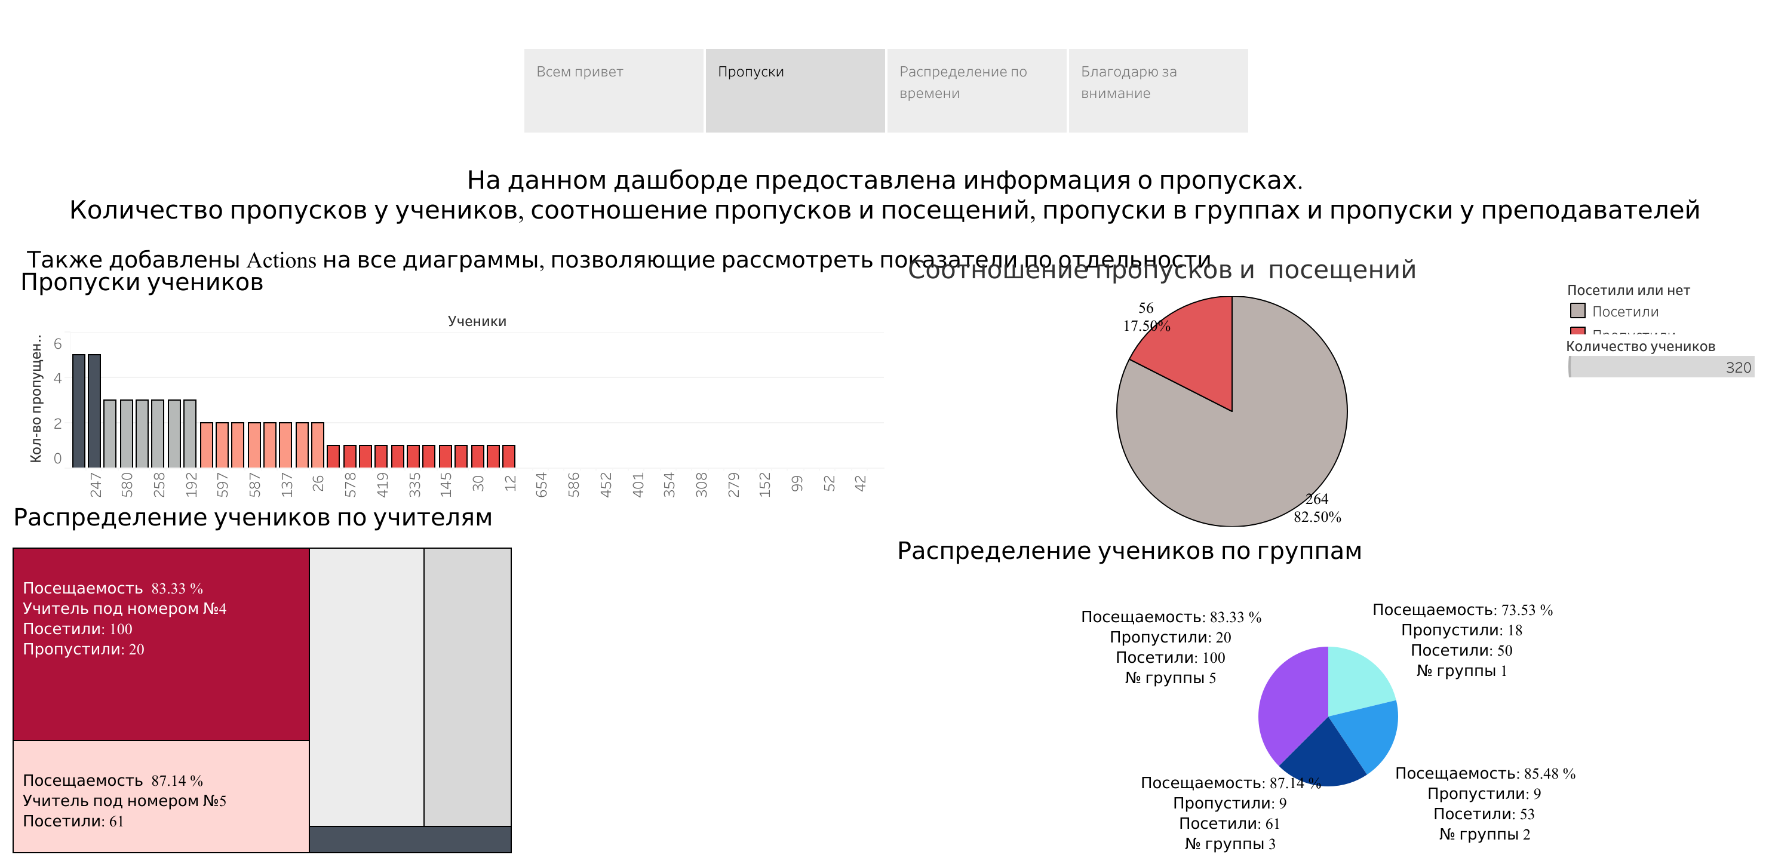

Slide 4
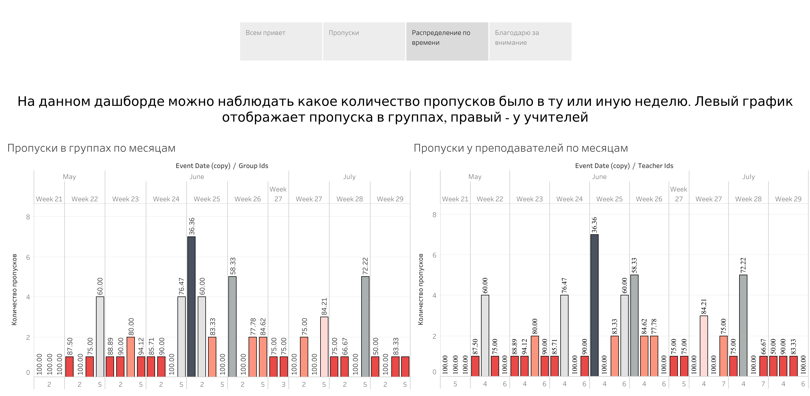

Slide 5
